Slide 1

Realising Our Potential – Irish Food exports
Declan Coppinger, Marketing Finance Manager

Slide 2


From the Beginning…

Slide 3
Minister Joe Walsh, T.D.

Slide 4


And so
27 years ago…
Bord Bia was established under An Bord Bia Act 1994*.
The functions of Bord Bia shall be to promote, assist and develop in any manner which Bord Bia considers necessary or desirable the marketing of Irish food and livestock and the production, marketing and consumption of horticultural product.
*and operates in accordance with the provisions of the Bord Bia Acts and Amendment Acts 1994, 1995, 1996 & 2004

Slide 5
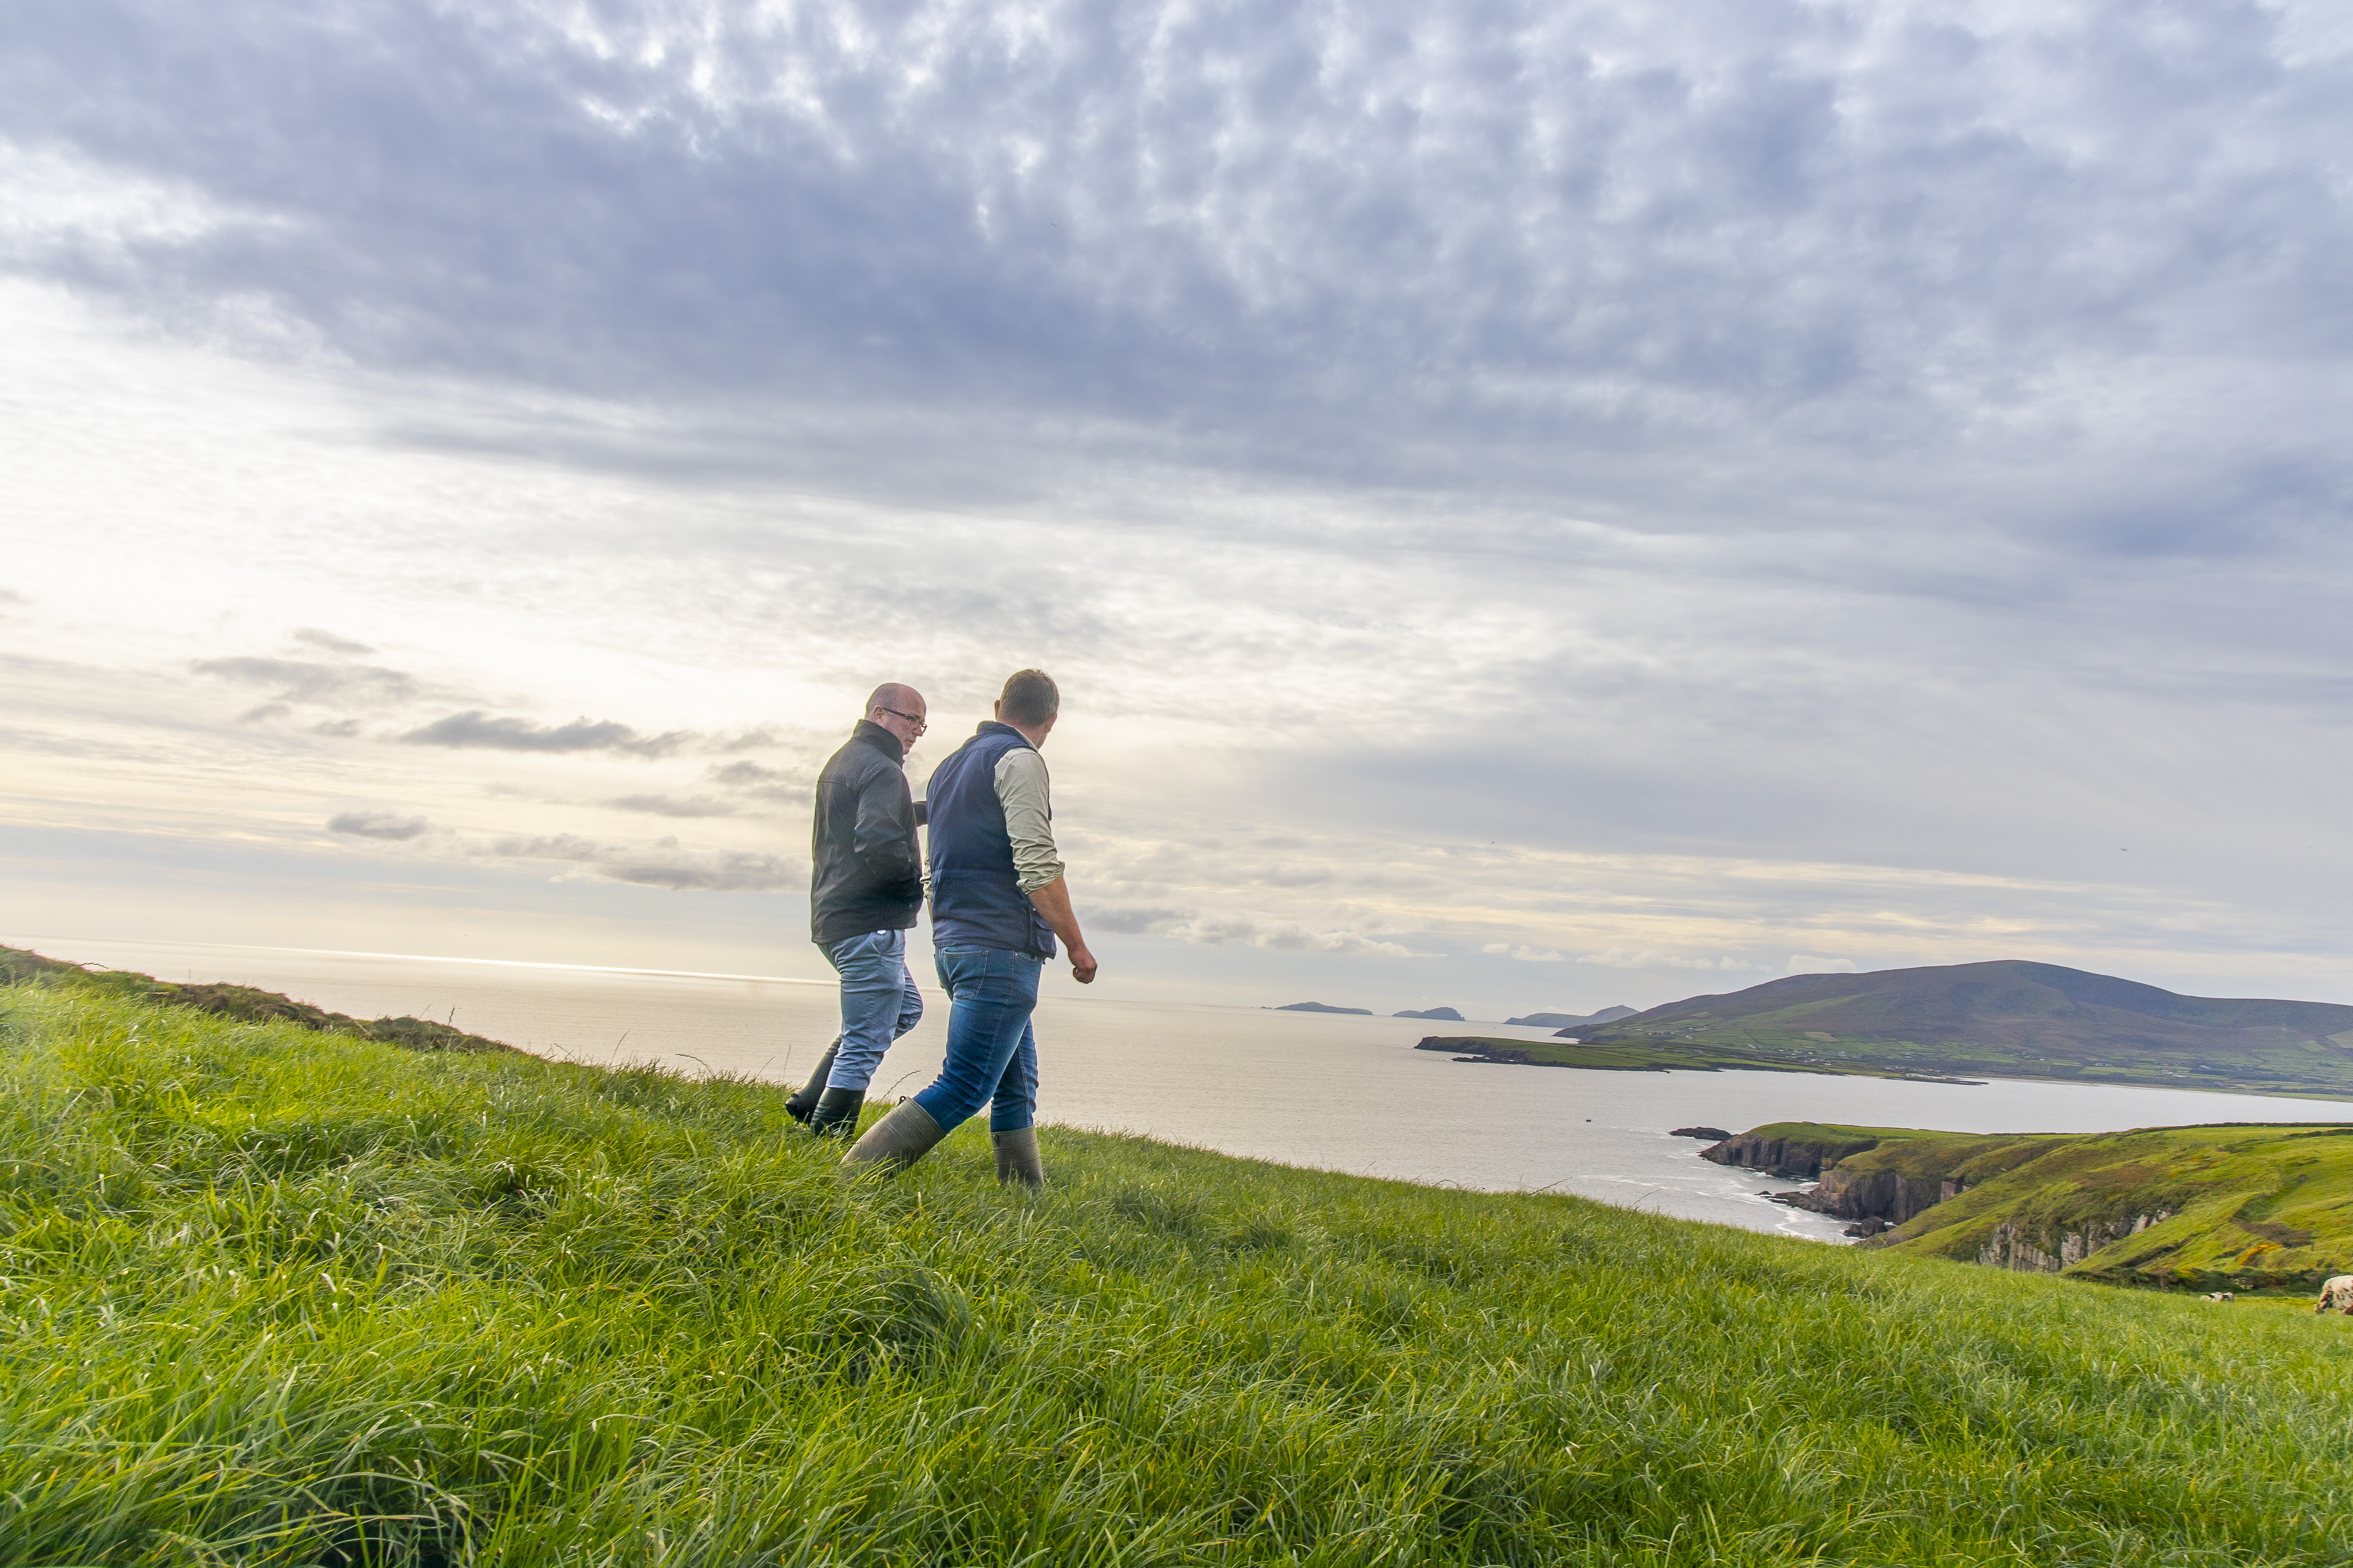

Our Remit
We exist to bring Ireland's outstanding food, drink and horticulture produce to the world - thus enabling the growth and sustainability of producers.

Slide 6
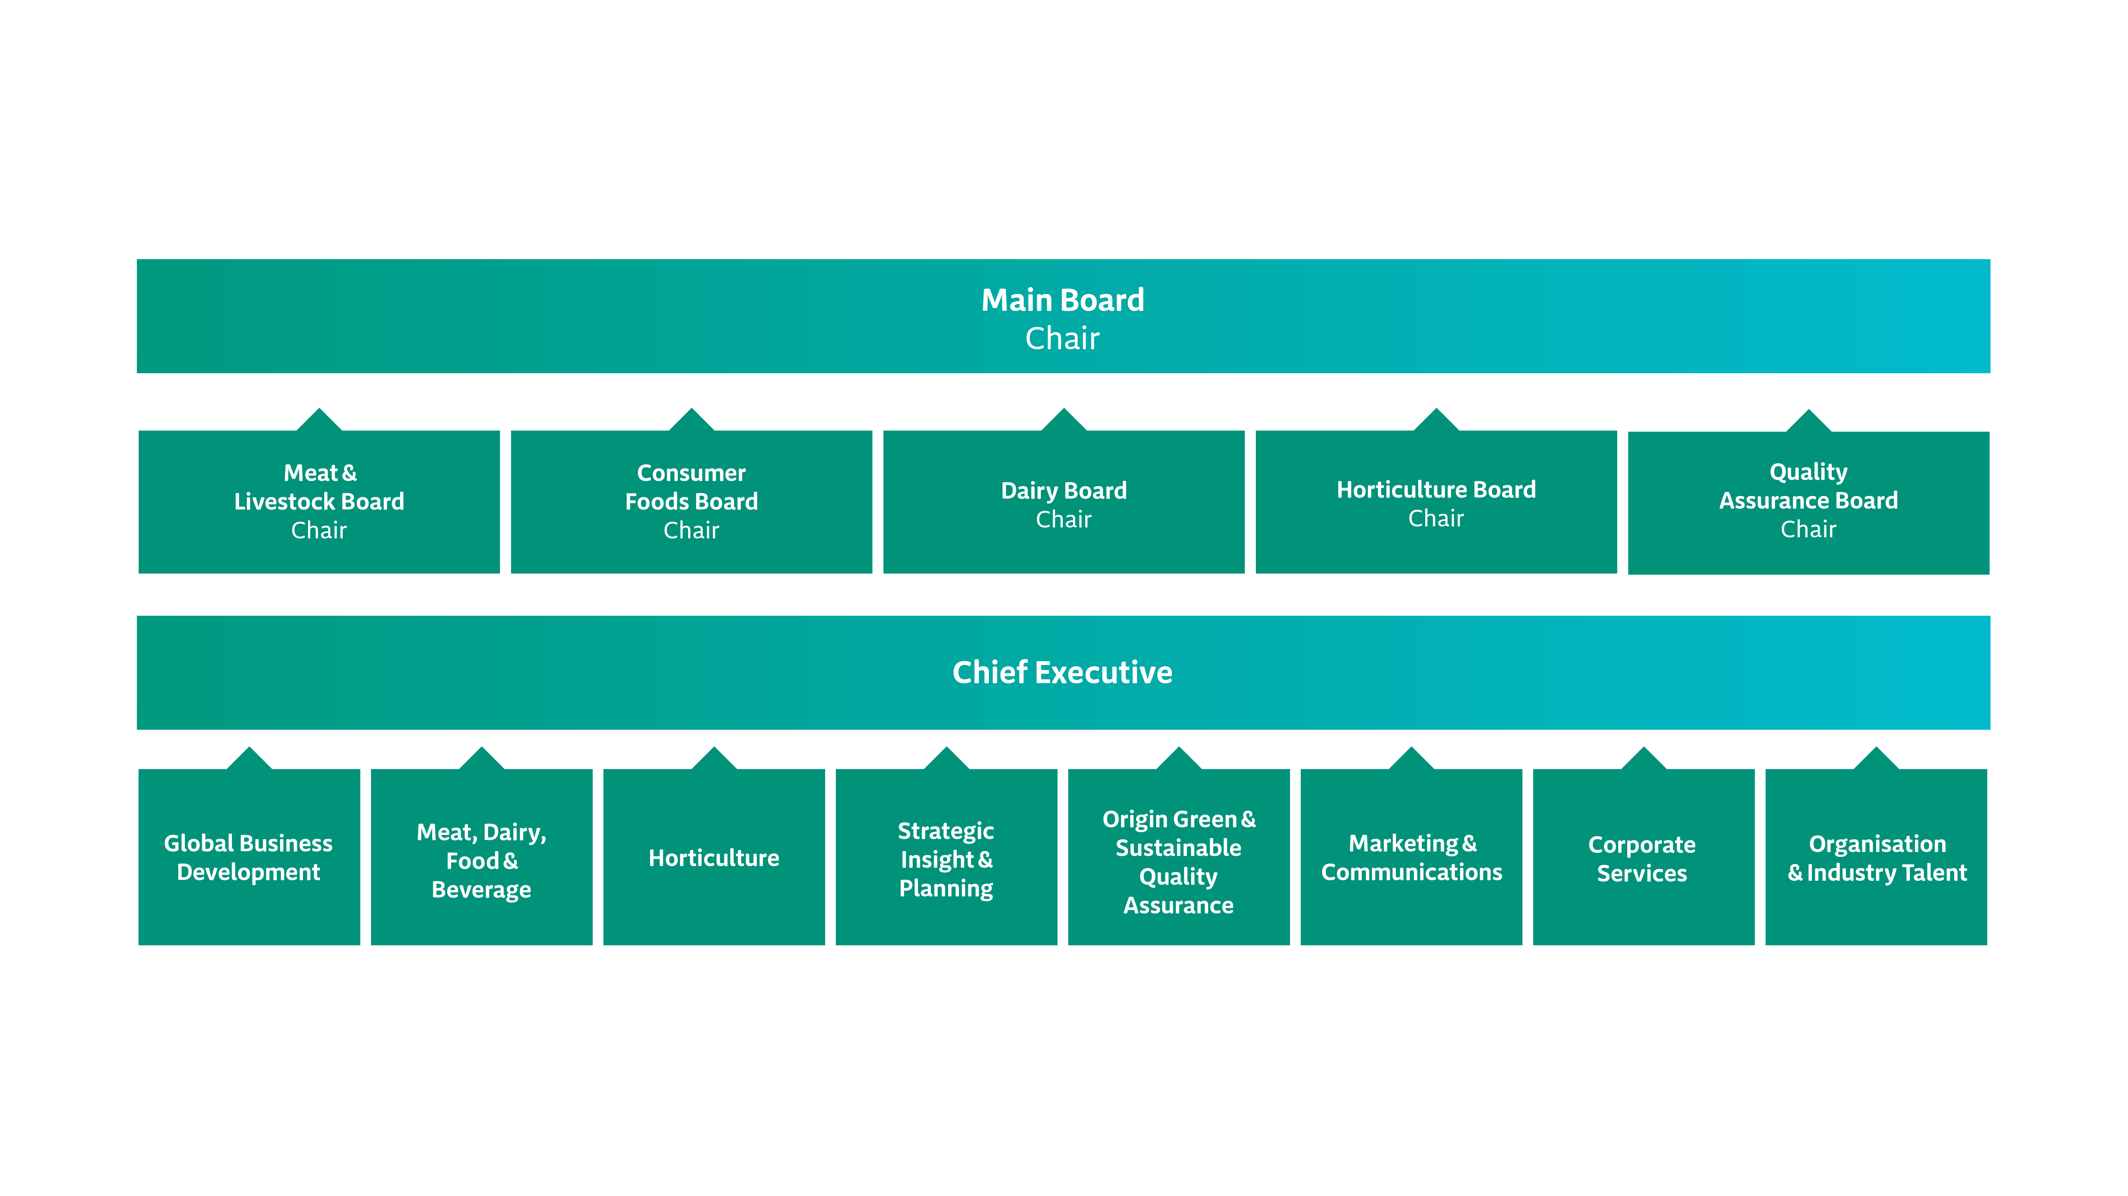
Organisation Structure

Slide 7
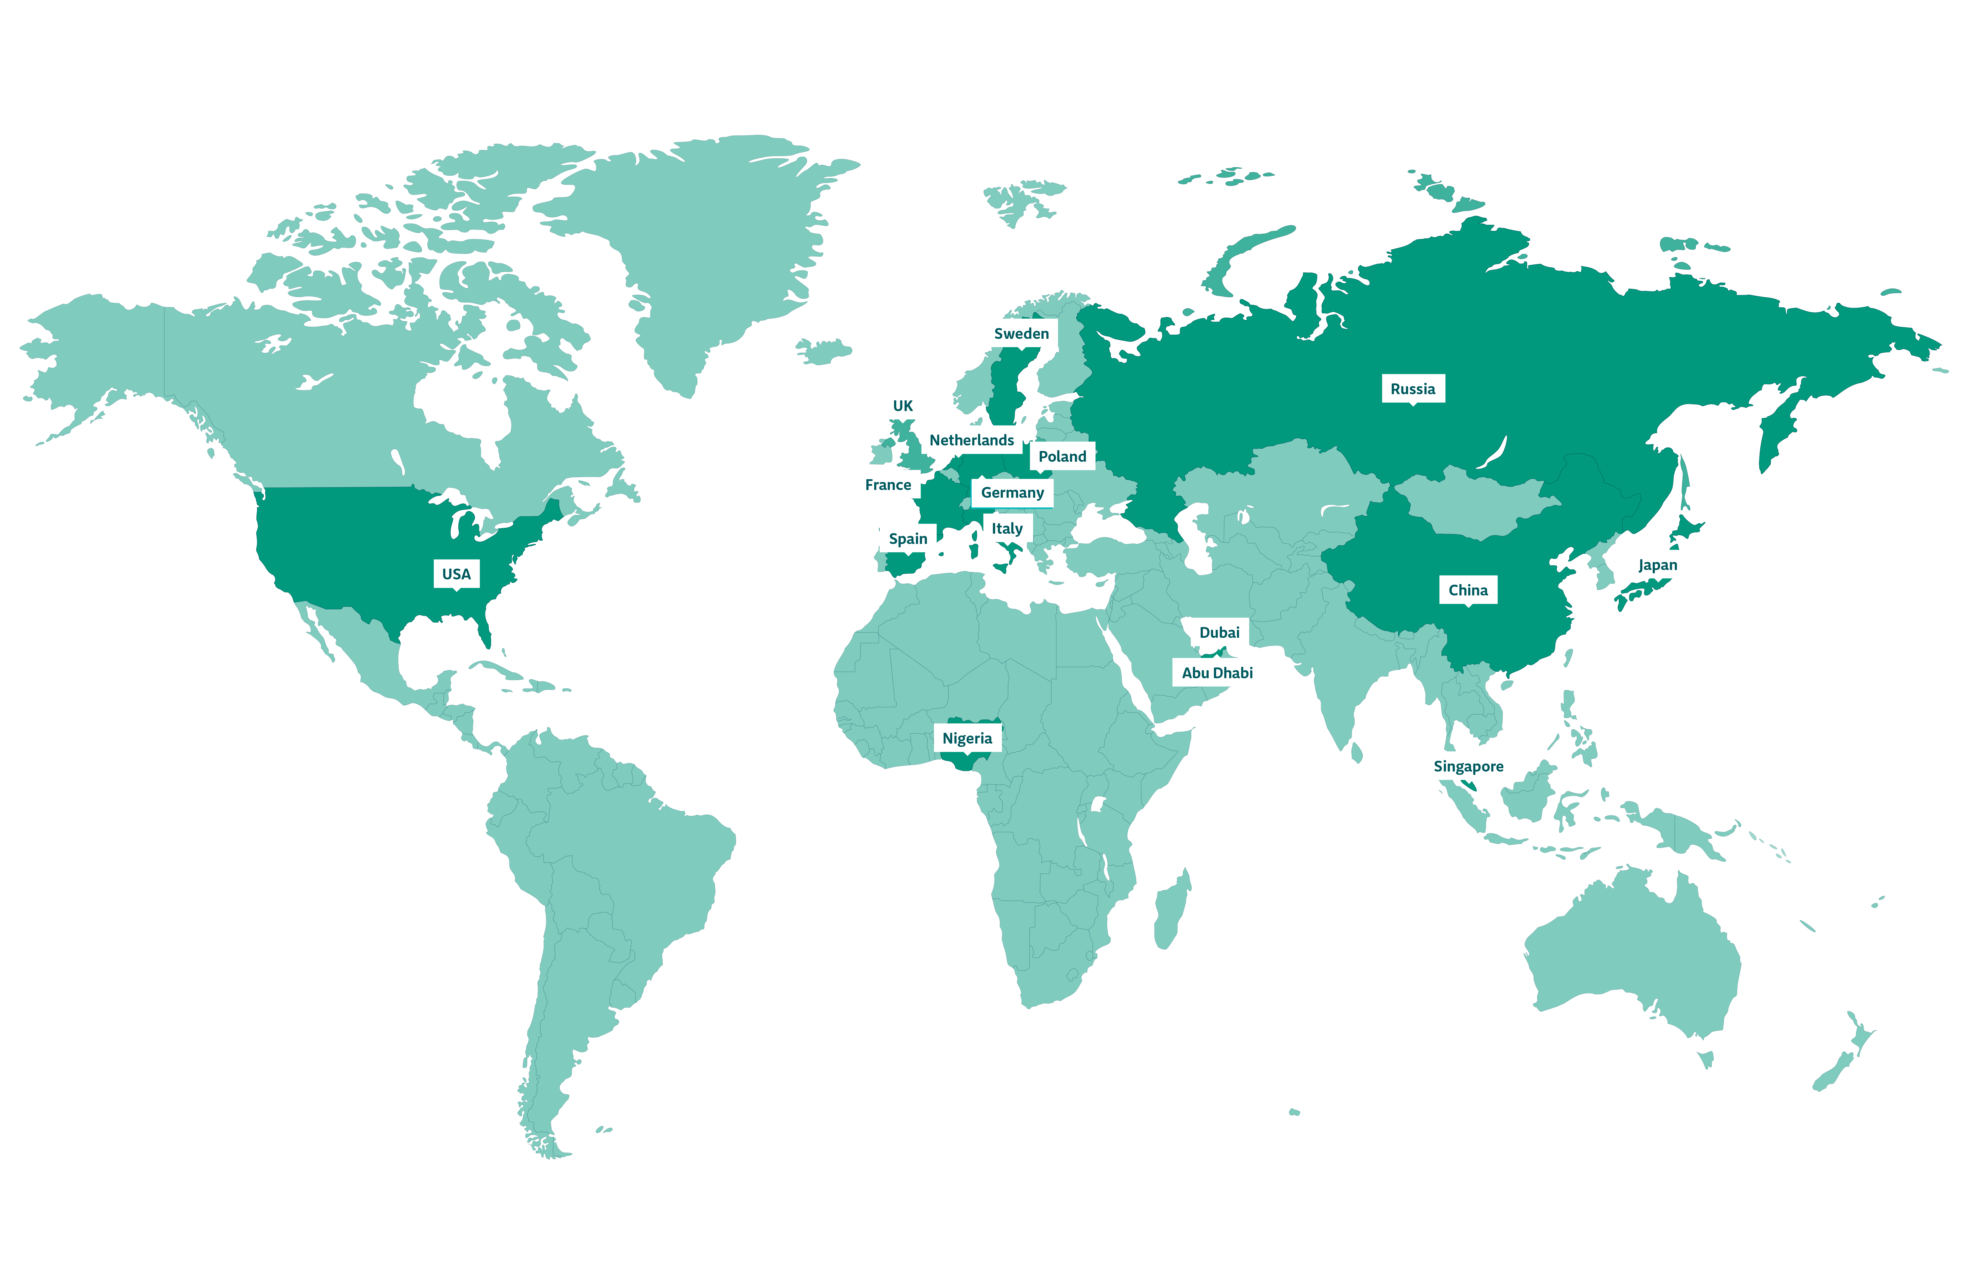
International Presence

Slide 8
Effective Enablers
Facilitating Growth Through
Lead Generation and Market Activation
Trade Fairs and Trade Missions
Marketing
Finance

Slide 9


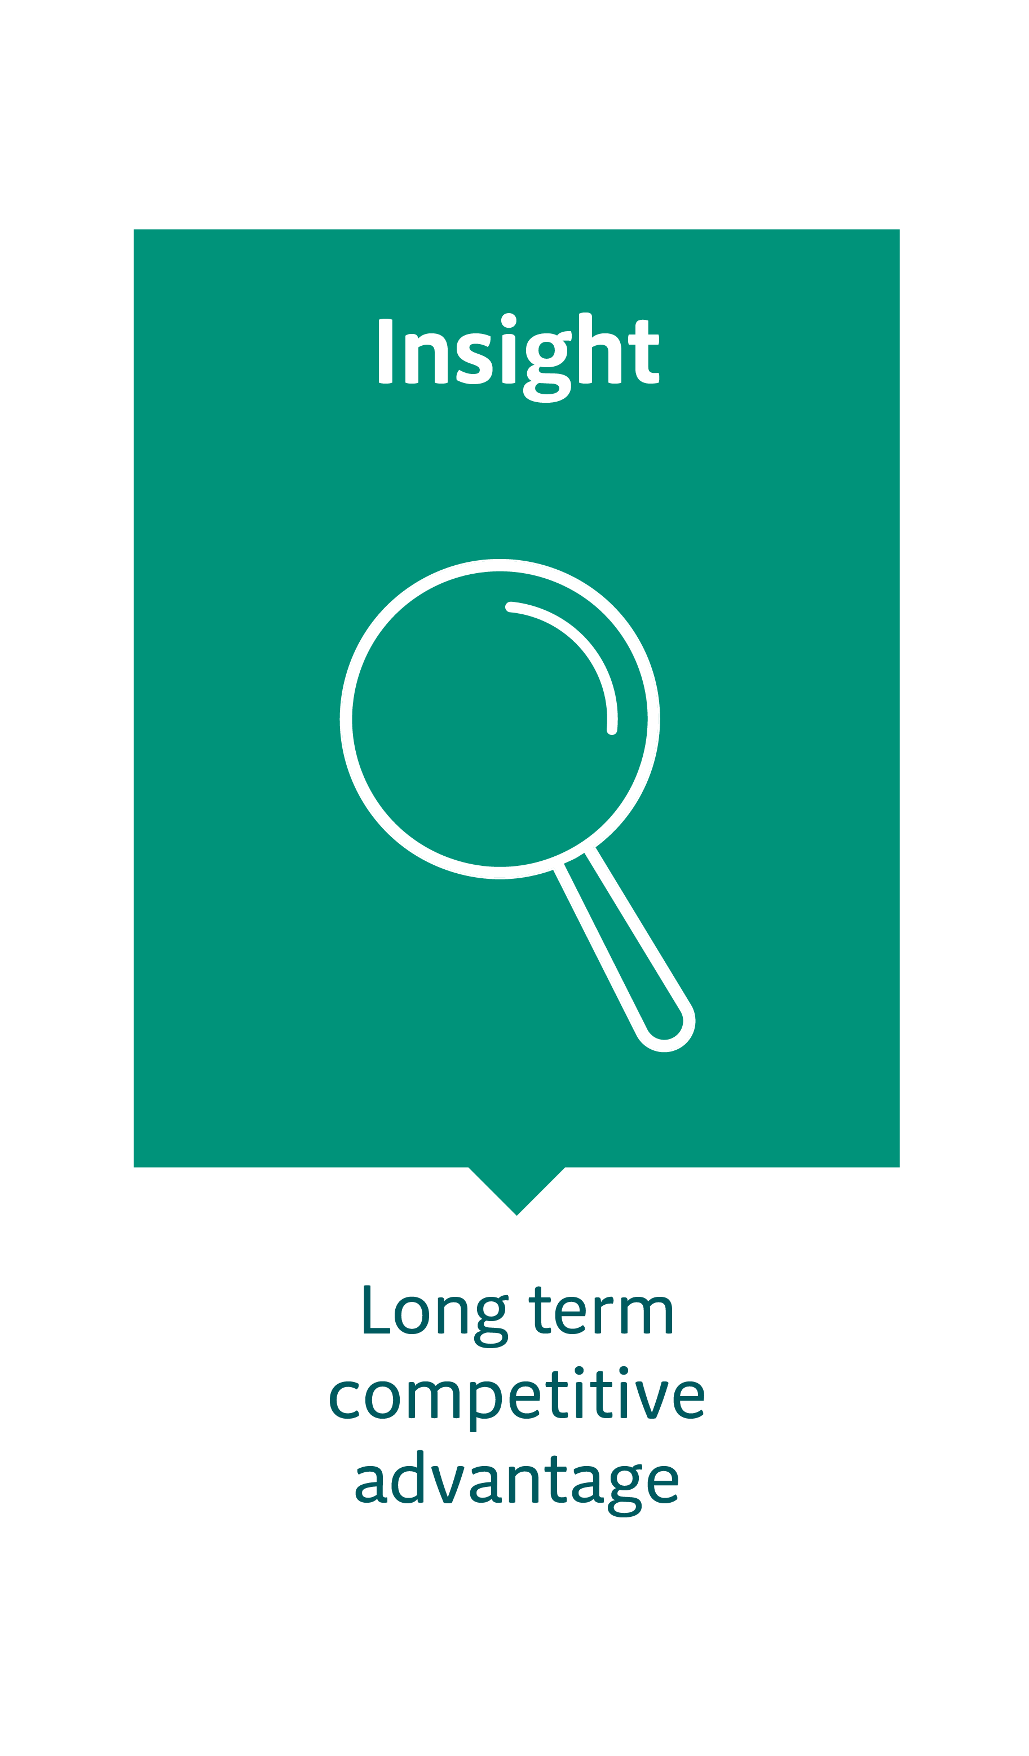

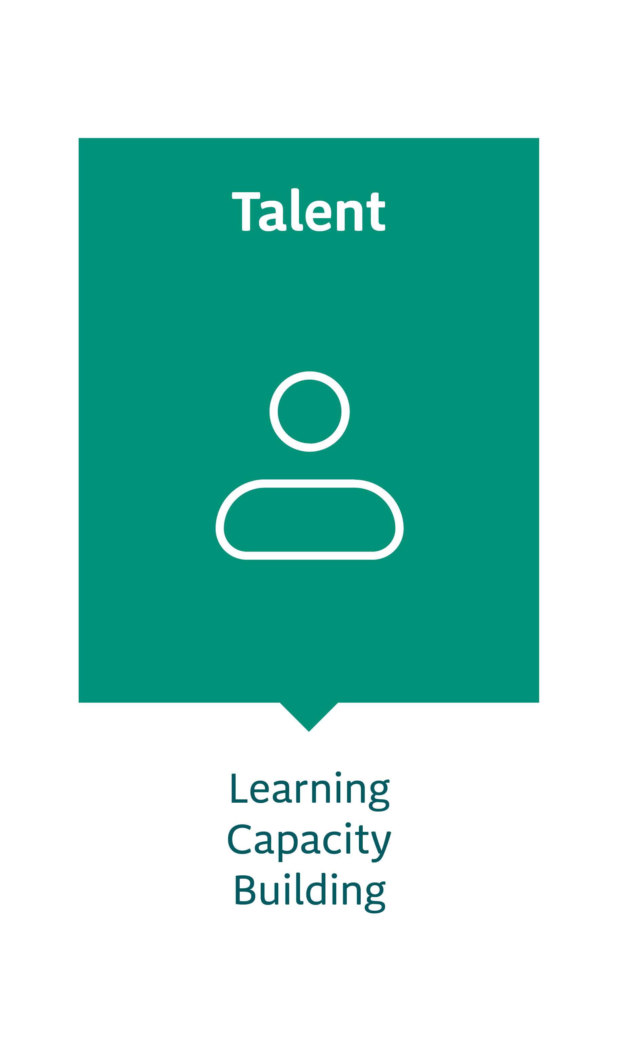
The Key Benefits We Deliver

Slide 10
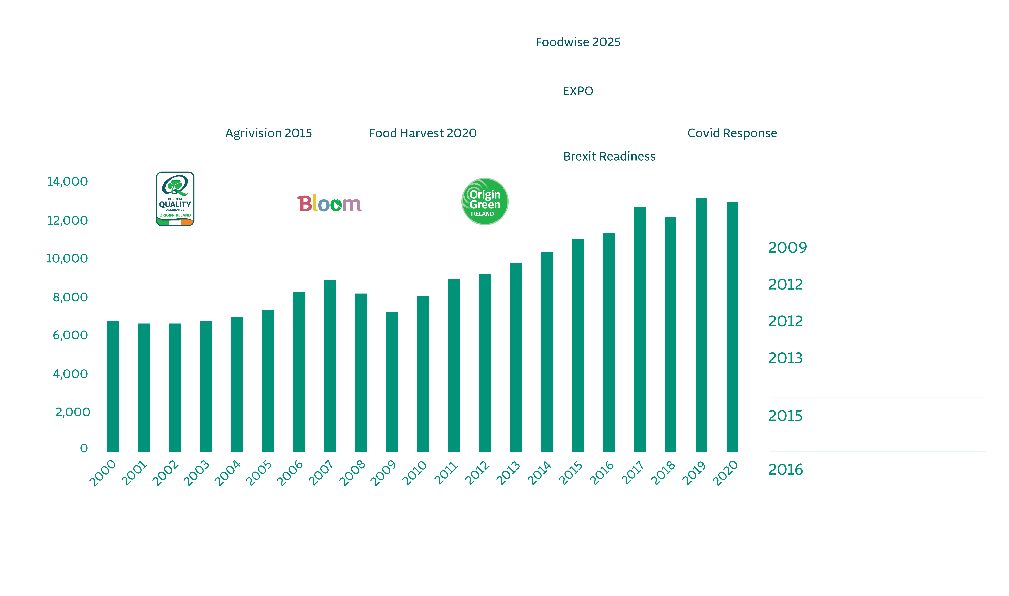
Irish Food and Drink Exports, 2000 to 2017 (€m)

Slide 11
Value of Irish Food and Drink Export

Slide 12
Destinations for Irish Food and Drink Export 2020

Slide 13
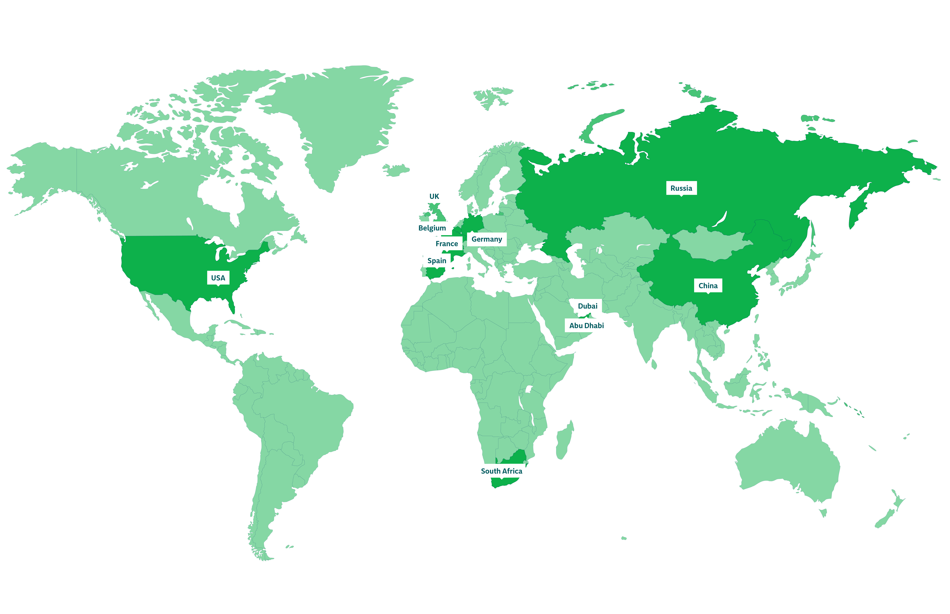
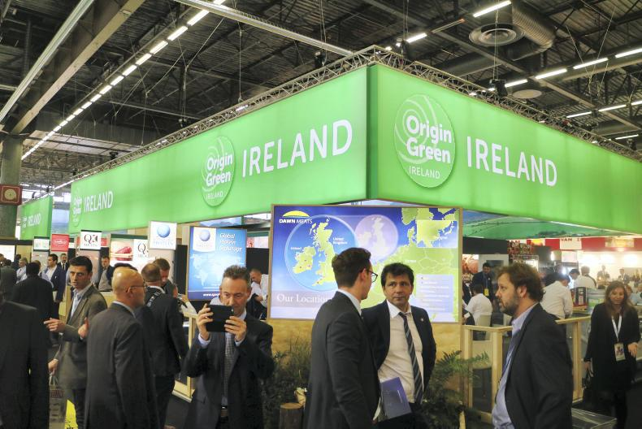

Trade Missions & Fairs Across the Globe
Whiskey L, Shanghai, China
World Seafood, Shanghai
I Meat Expo
SEG - Seafood Expo Global, Barcelona
Food & Hotel Vietnam
Food Ingredients Asia
CIMIE (Pork & Poultry)
Guangzhou Fishery &
Seafood Expo, China
Sirha
Japan International Seafood
Anuga
Bar Convent, Berlin
Sandwich & Snack Show
Pork Expo
TUTTOFOOD, Milan
China Fisheries & Seafood Expo
FHC (Food Hotel China)
Coex Food Week
Food Ingredients Europe
Plma

Slide 14
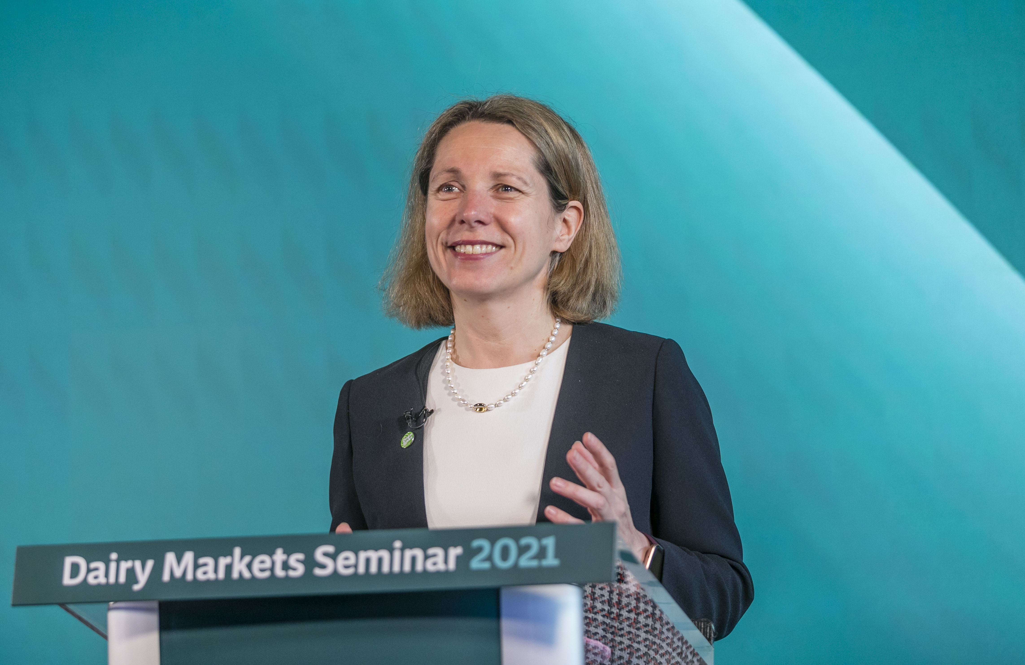
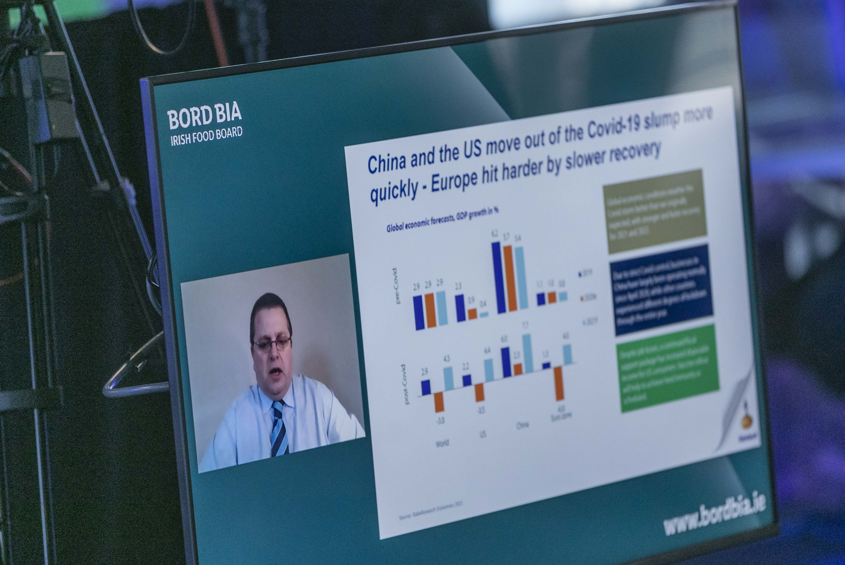
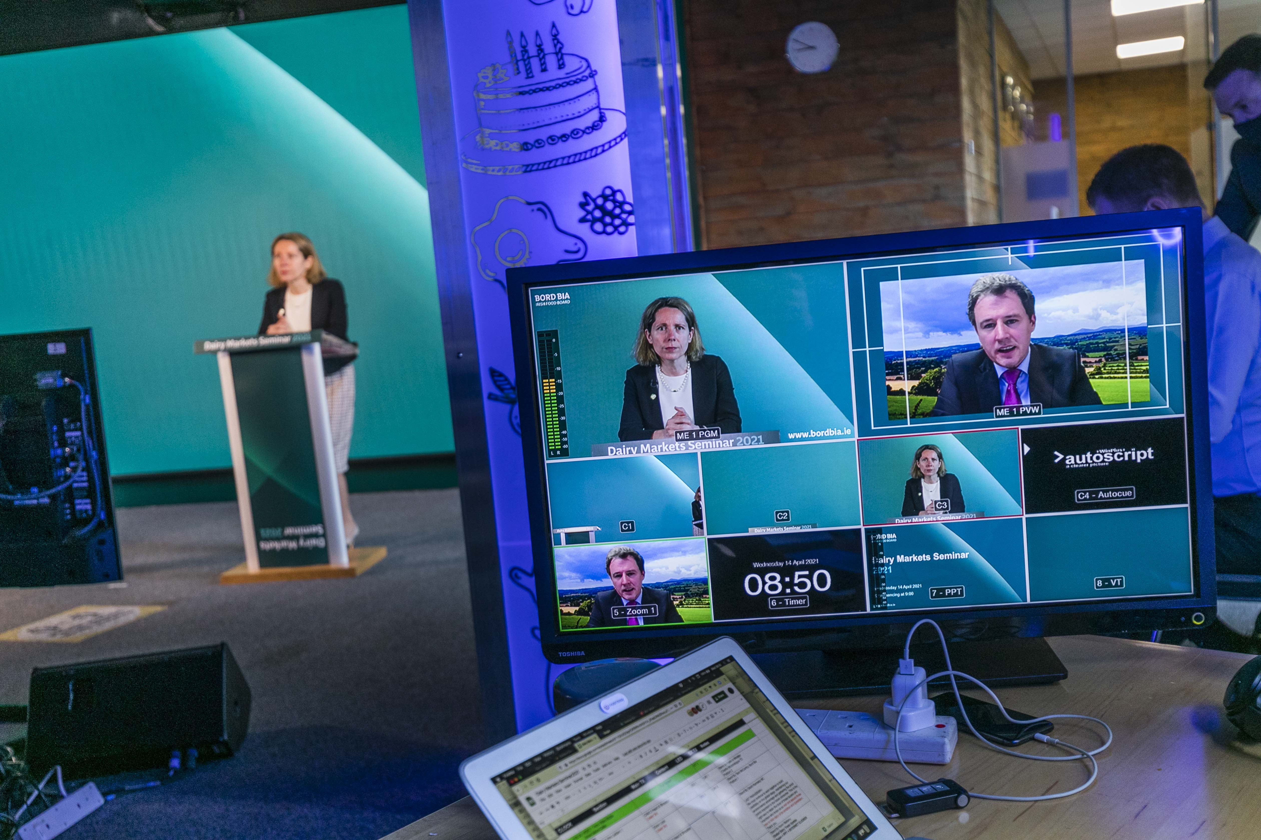
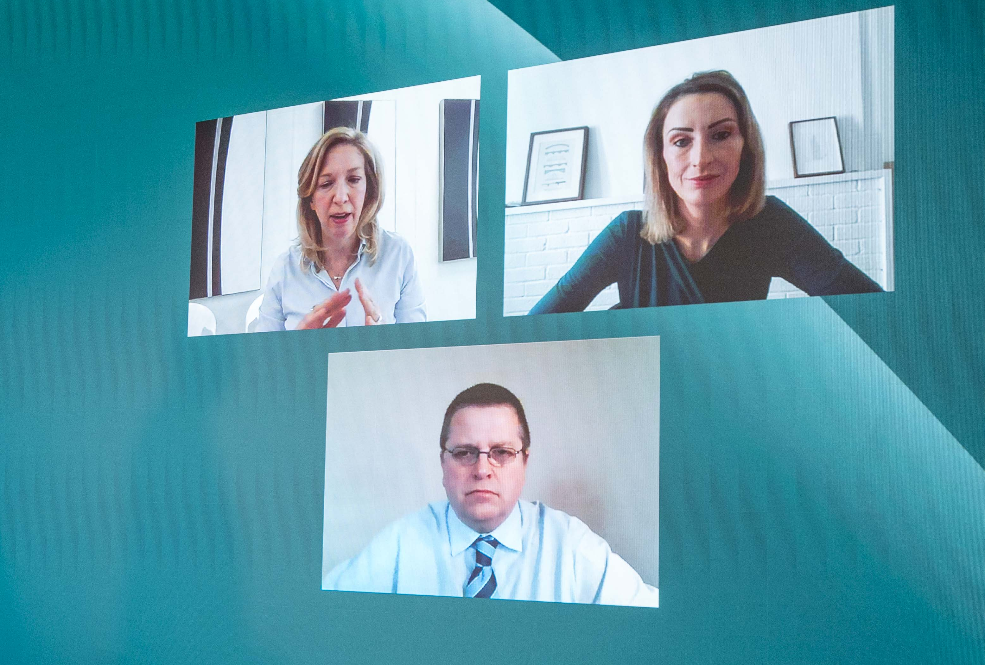
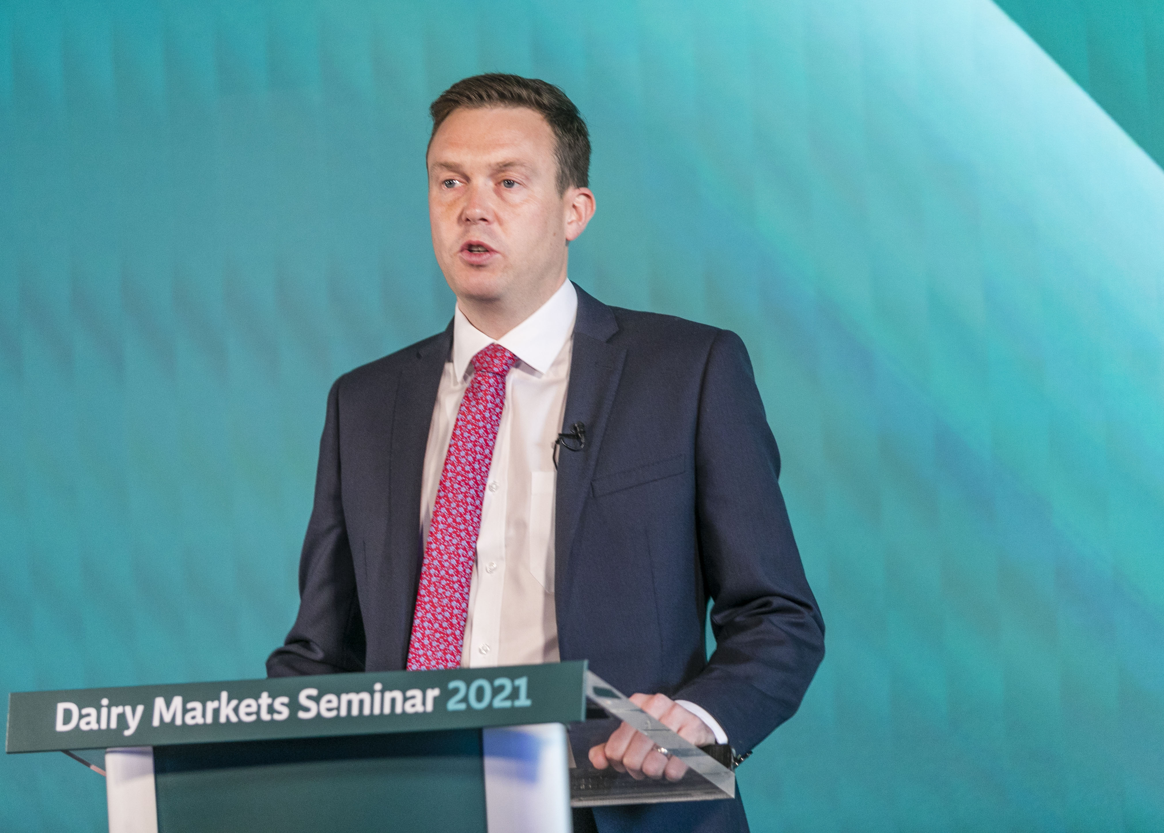
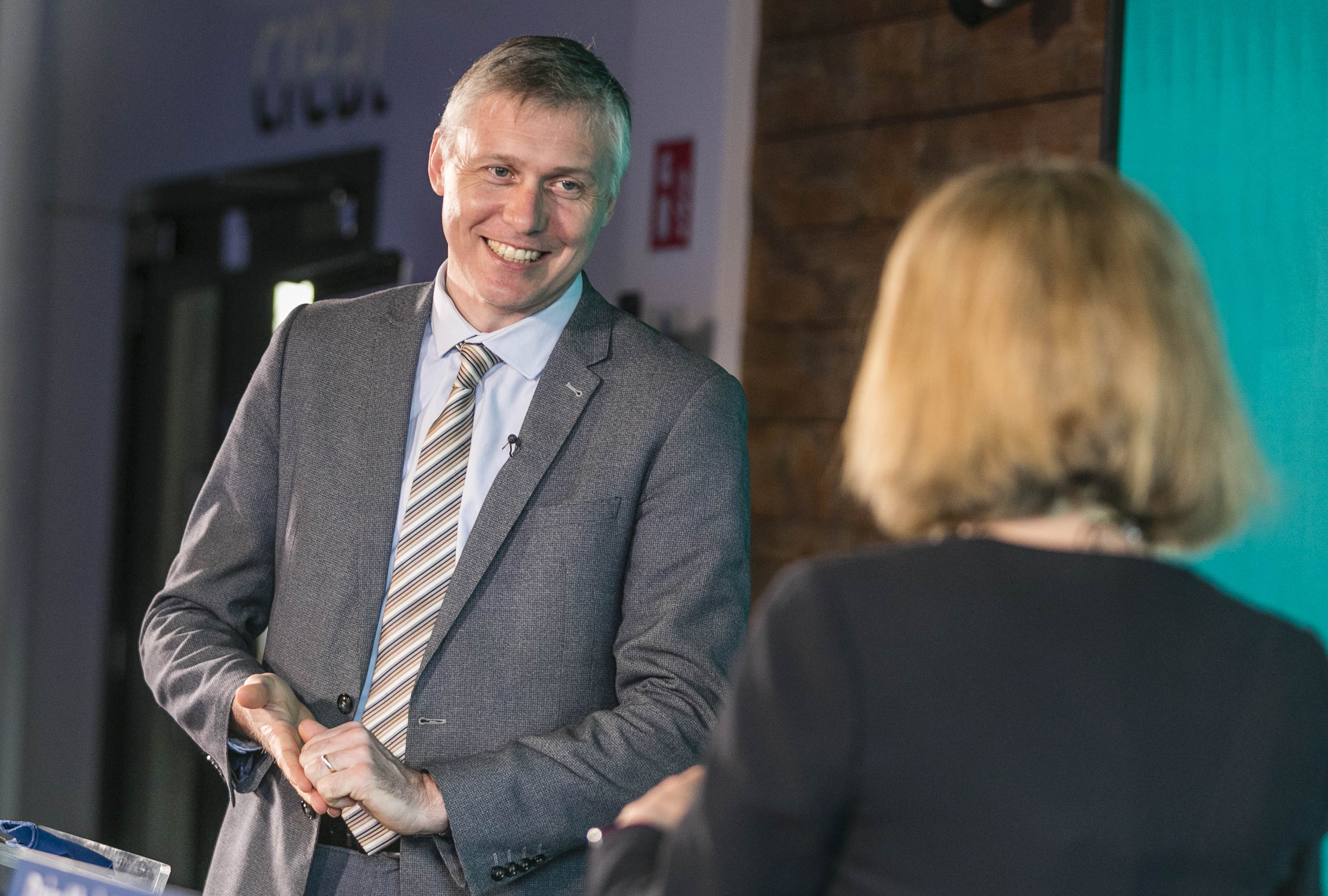
Virtual Trade Show

Slide 15










Uniquely Positioned as a Partner
in the Government Ecosystem
Notes:
A collaboration which is supported by a framework of Memoranda of Agreements which clearly define our Ways of Working with peer agencies and clarified in the Peer actions of Foodwise 2025, reported to the Minister through his chaired High Level Implementation Committee of which our CEO – Tara McCarty is a member.

Slide 16

10 Year Strategic Outlook & 3 Year Strategic Statement
Ethics in Public Office Acts ; Standards in Public Office Act; Freedom of Information Act; EC Directives on Public Procurement; National and EC Data Protection Law; Ethics in Public Office Act; Government Guidelines for State Bodies; Code of Practice for the Governance of State Bodies; Employment Law; Standards in Advertising & Communications; Copyright Law; Confidentiality; State Aid Rules; Internal Auditing; C&AG Auditing; Supplier Management, Contracts, Due Process and Value for Money.

Slide 17

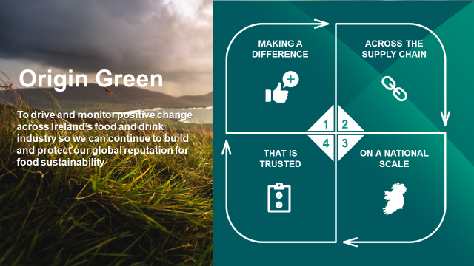

Slide 18

Over 53,000 farms and
320 leading Irish food and drink companies

Slide 19



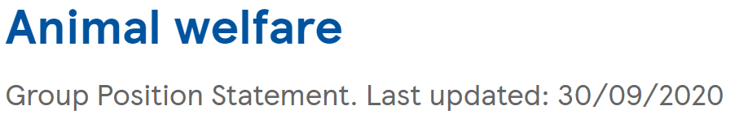



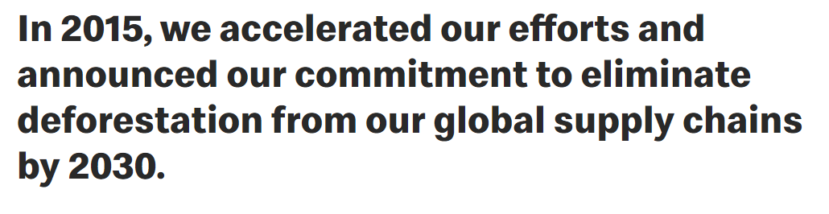




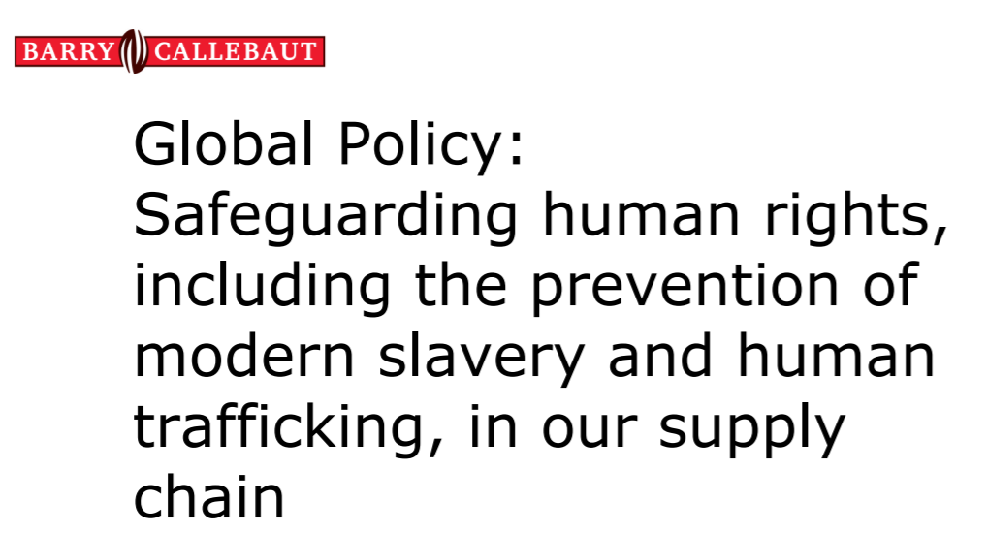
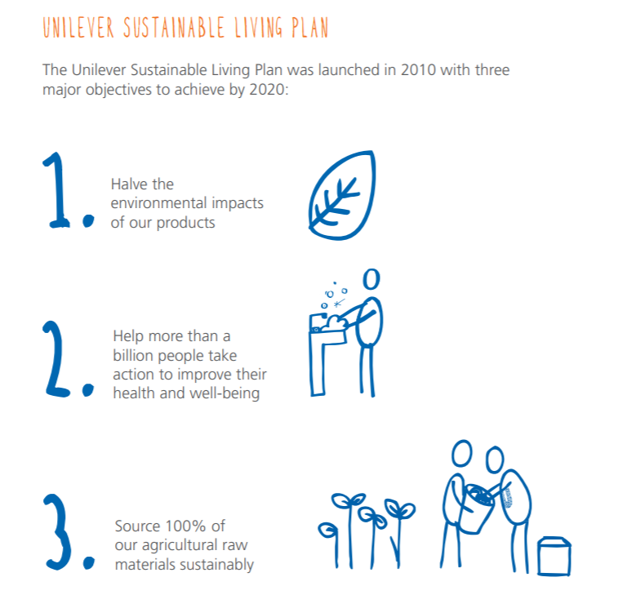


Customer Requirements
Value chain (scope 3) emissions target = 15% ↓

Slide 20

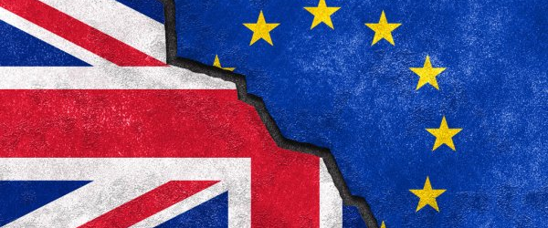

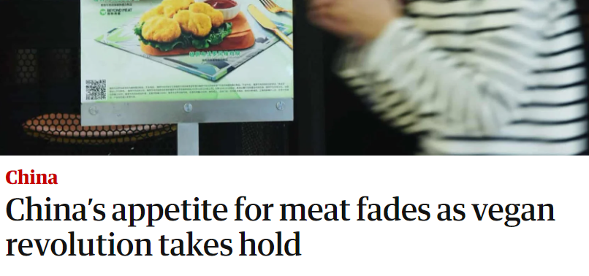

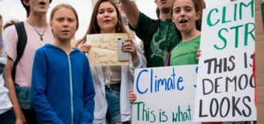

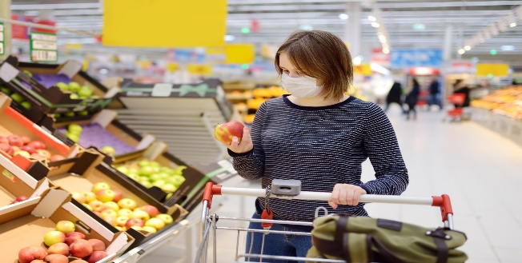

Future Proofing in a New World
POLICY REQUIREMENTS
BREXIT
MEDIA ATTENTION
NEW TRENDS & SUSTAINABLE NUTRITION
YOUTH ACTIVISM
COVID-19

Slide 21

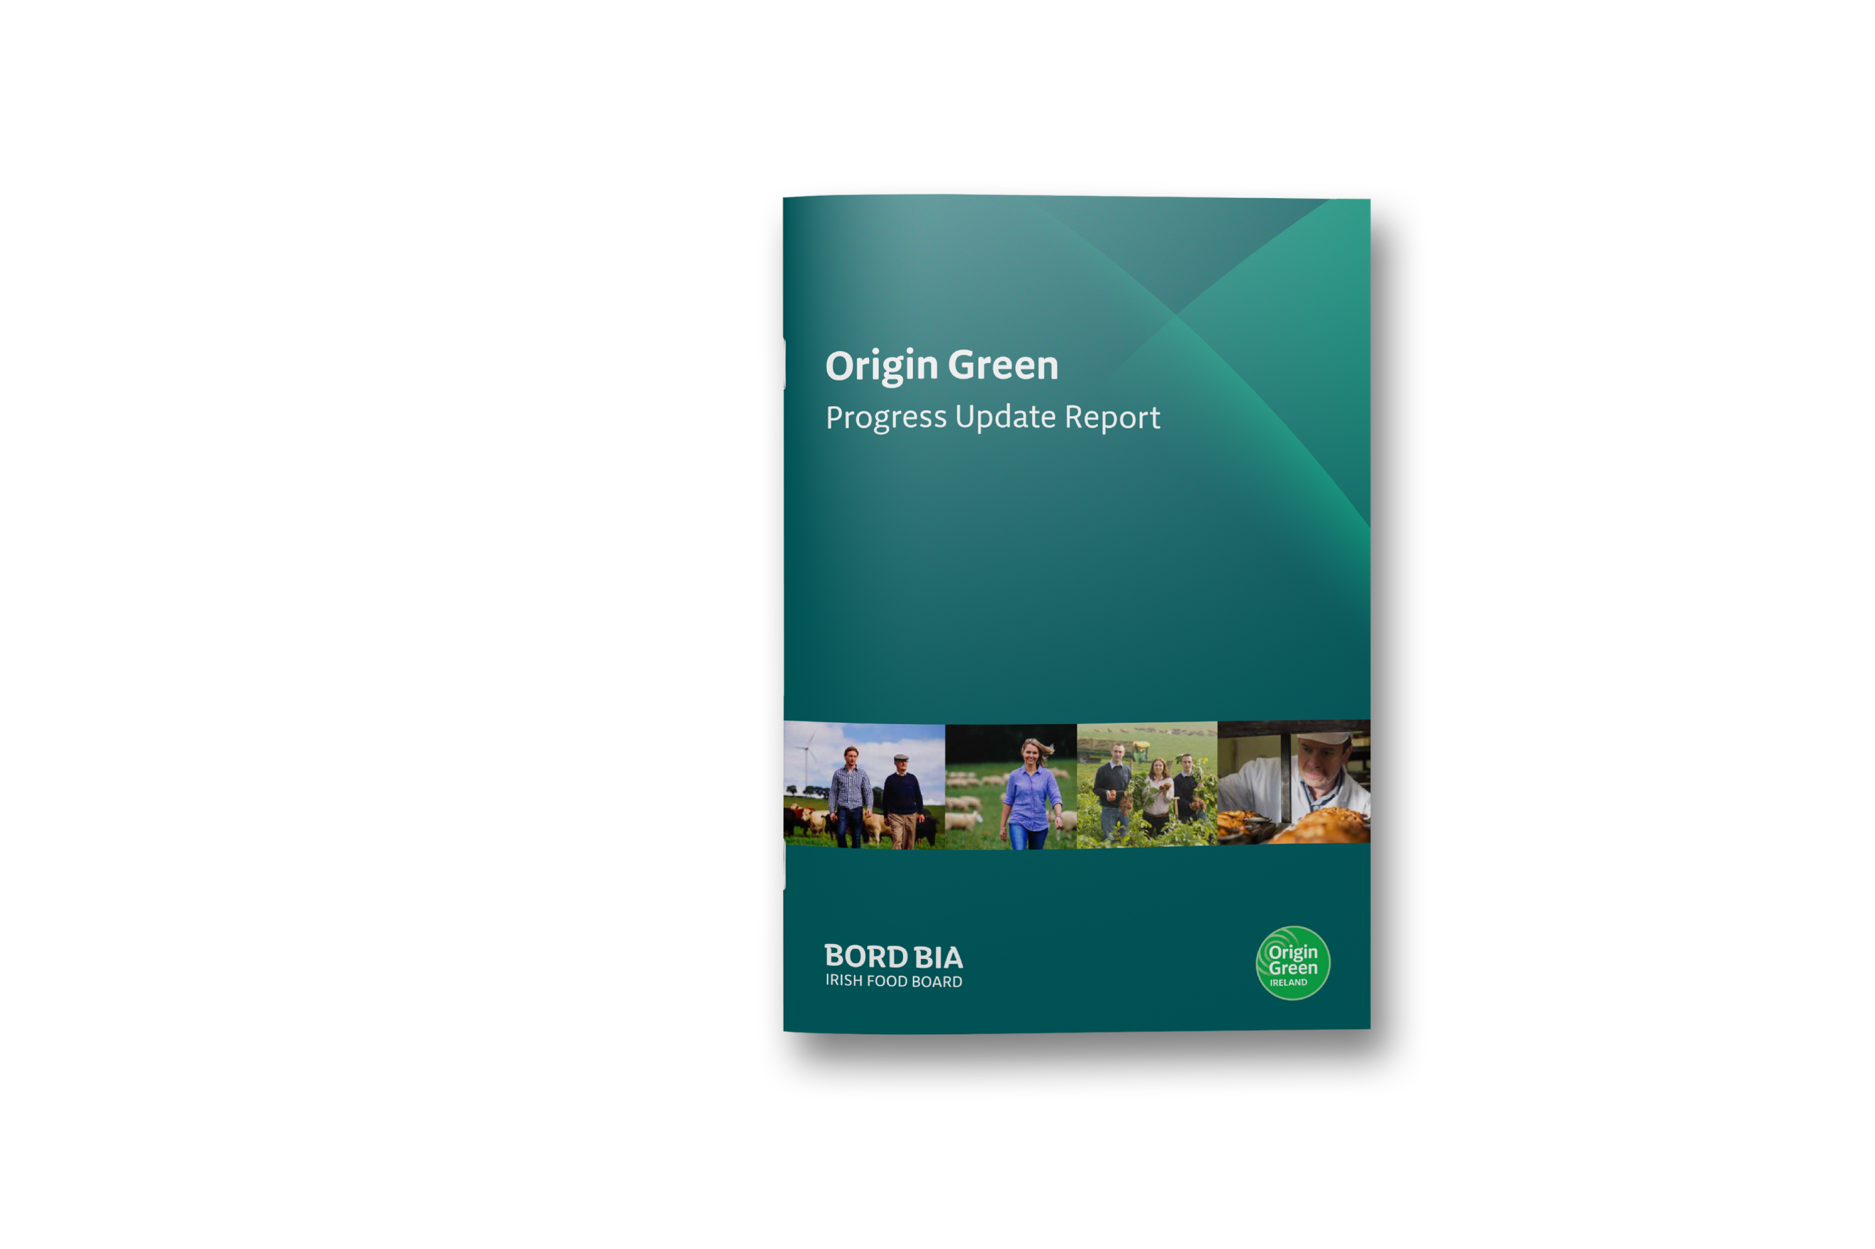
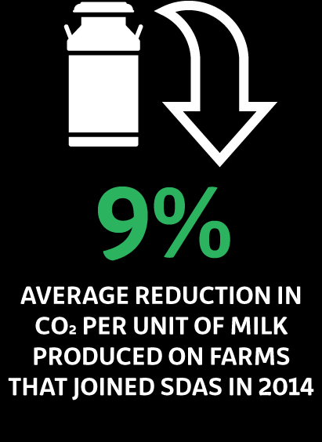
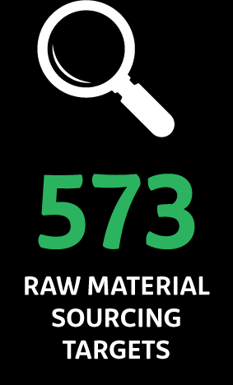
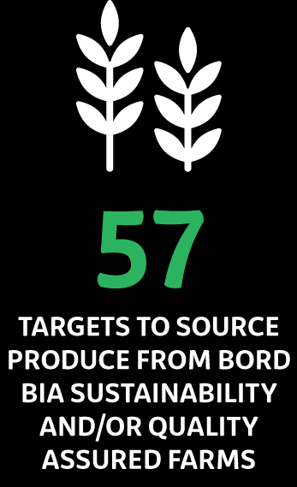
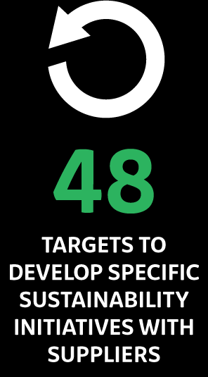
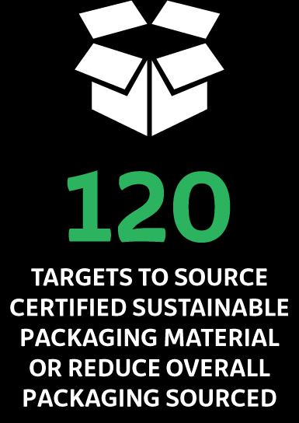
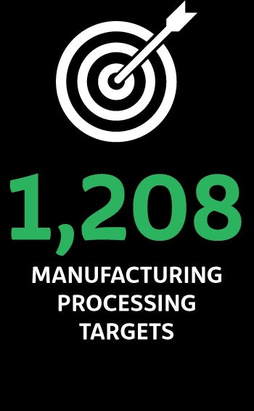
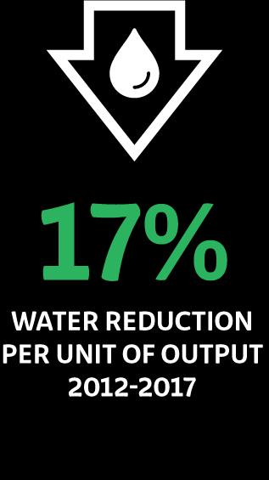
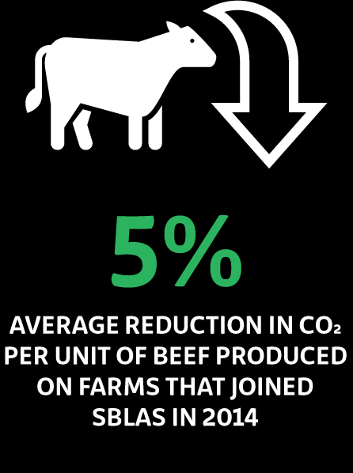
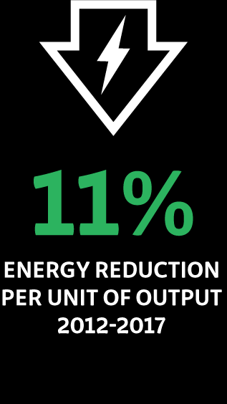
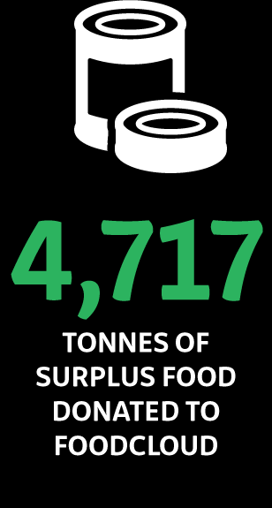

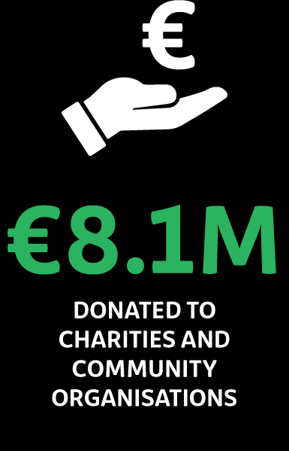
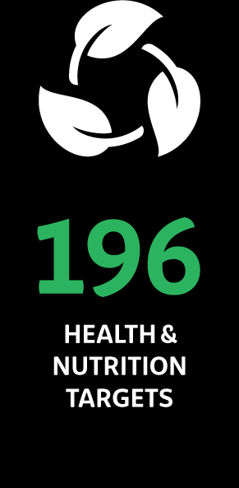
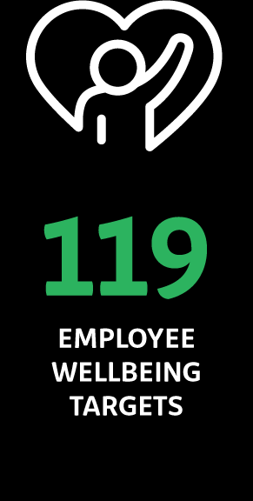
Proof and Progress:
Key Results

Slide 22
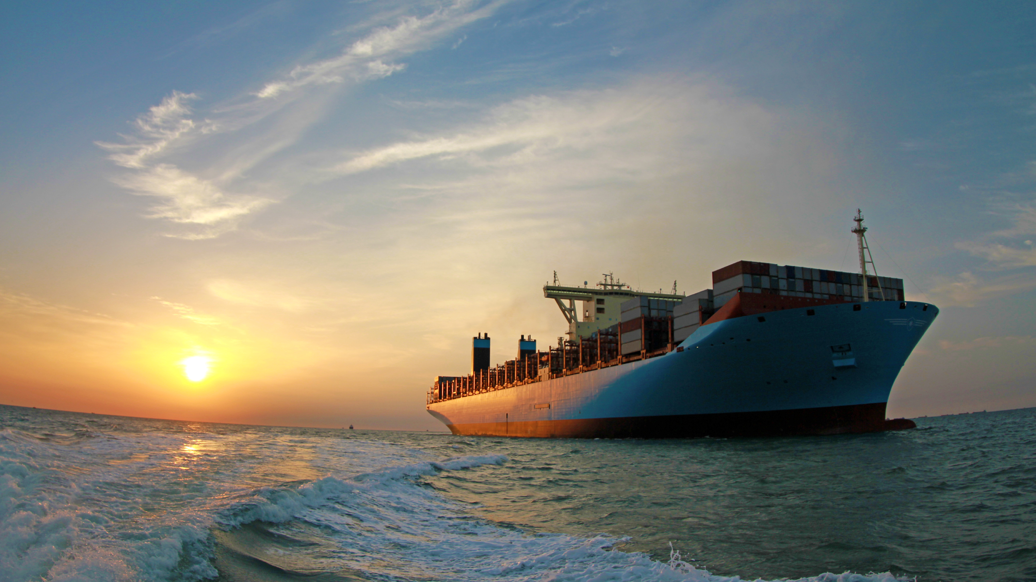
We have come a long way

Slide 23
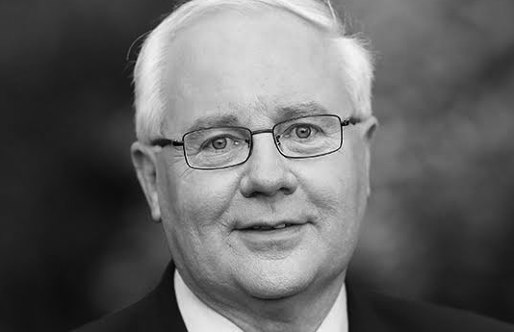
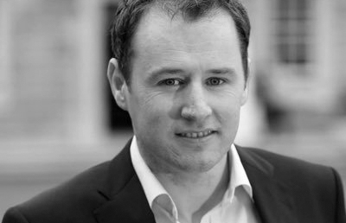
Through Our 27 Years...

Slide 24

An Ambition for Growth

Slide 25


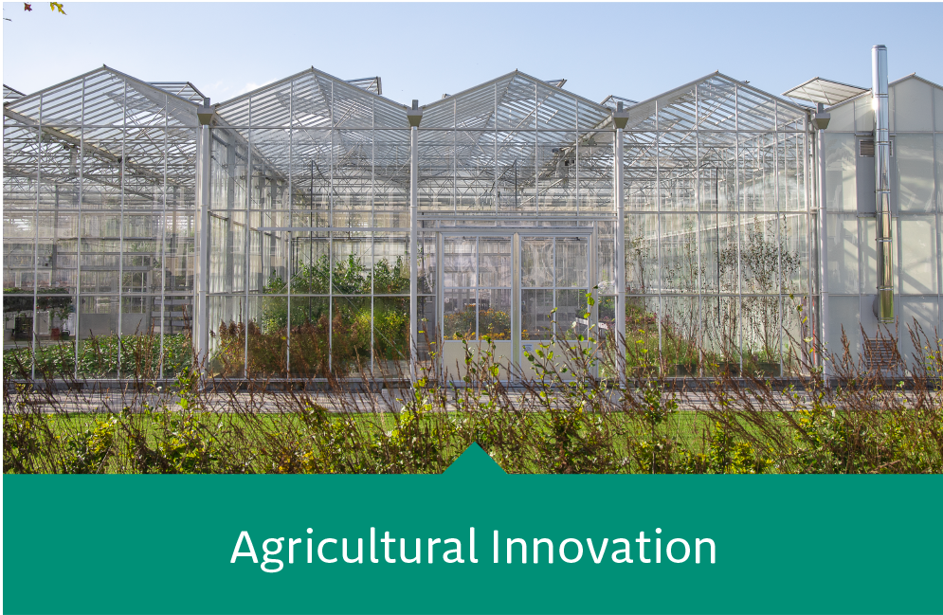
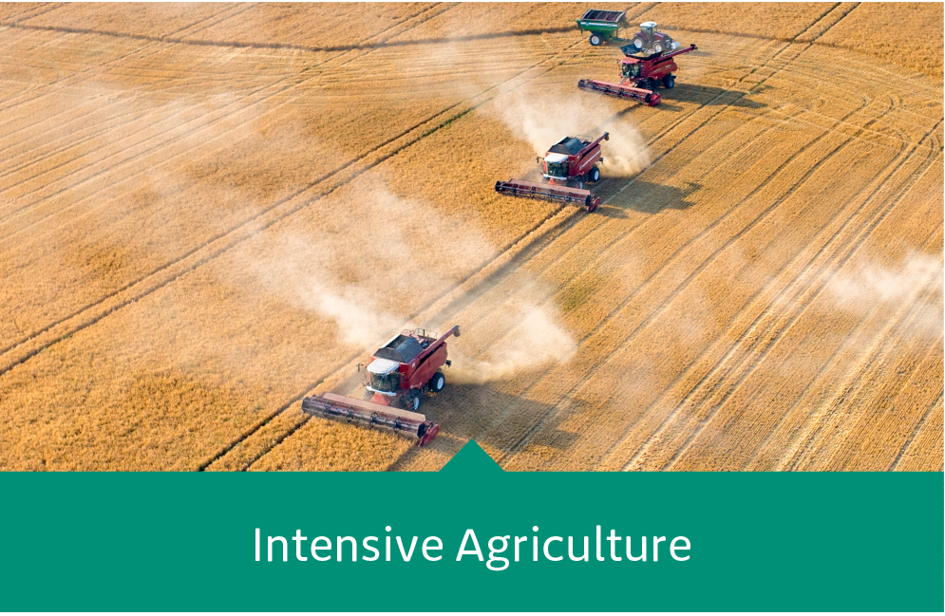


Accelerating Complex Challenges

Slide 26
Thank You
Go Raibh Maith Agat

